Slide 1
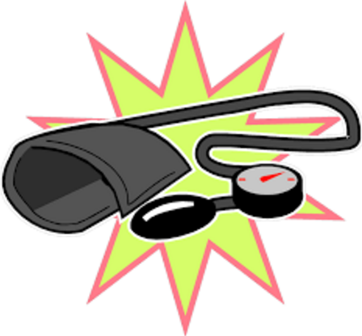
Blood Gas Homeostasis: Regulation of Heart Rate and Blood Pressure
Chapter 8 Human Perspectives

Slide 2
Function of Circulatory System in Gas Homeostasis
Heart pumps blood, vessels carry blood
O₂, CO₂ transported in blood stream
Heart rate and blood pressure affect how quickly:
O₂ is carried from lungs to tissues
CO₂ is carried from cells to lungs for removal

Slide 3
Vocabulary: Heart Rate: Number of times heart beats per minute
Stroke Volume: Amount of blood (mL) leaving heart with each beat
Cardiac Output: Amount of blood leaving the heart each minute
= Heart Rate x Stroke Volume
Blood Pressure: force of blood on vessel walls. Depends on:
Whether heart is contracting (systole) or relaxing (diastole)
Cardiac Output (as CO increases, BP increases)
Diameter of blood vessels (constriction increases BP)

Slide 4
Regulation of Heart Rate and Blood Pressure
Changes in body are detected by receptors eg:
Chemical Composition of Blood: Chemoreceptors in Aortic and Carotid Bodies
Conscious awareness of changes eg danger/fear
Changes in blood volume and pressure: receptors in vessel walls
Information sent to:
Medulla oblongata – cardiac centre (cardiovascular regulating centre)
Signals sent via Autonomic Nervous System to heart and blood vessels, to affect blood pressure, heart rate, stroke volume, cardiac output

Slide 5
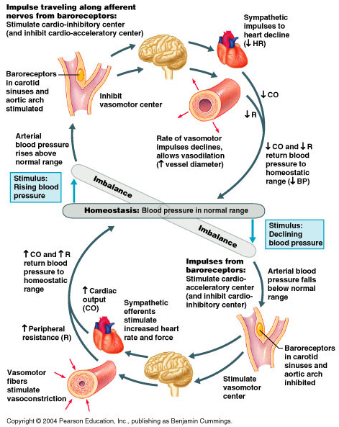

Slide 6
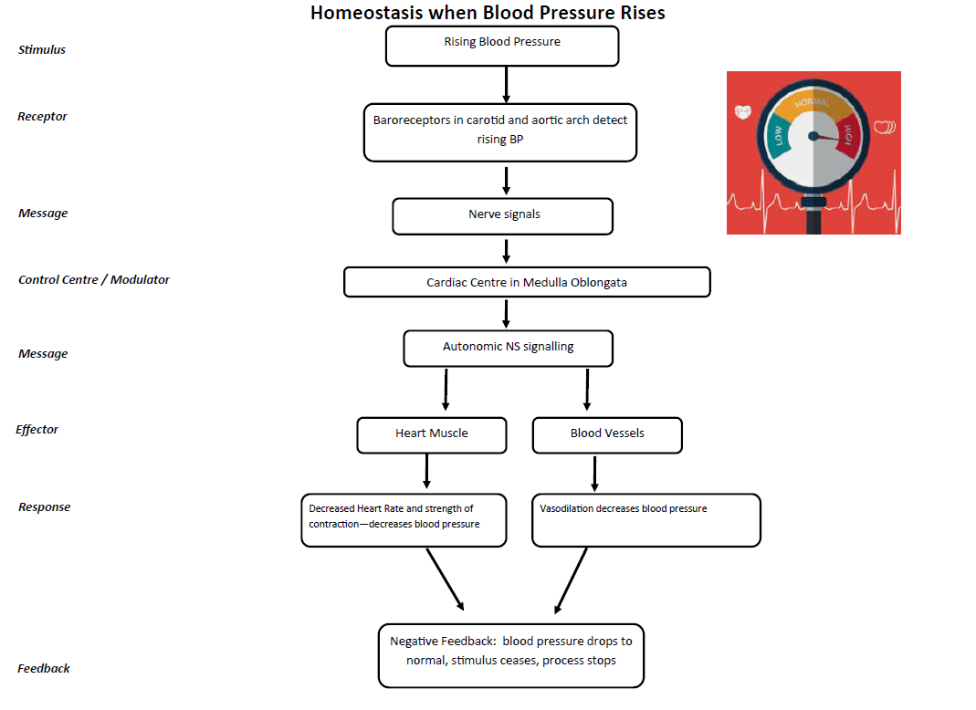

Slide 7
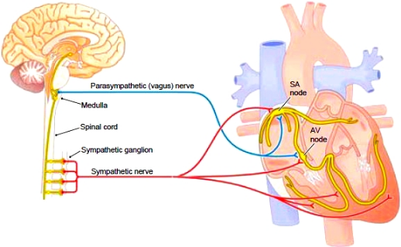
Heart Rate Regulation
Primarily via autonomic NS stimulation

Slide 8
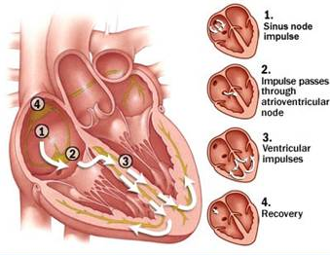
Coordination of heart beat
Autonomic NS stimulates receptor within the heart:
Sinoatrial Node: “pacemaker” – controls the electrical conduction system that controls heart contraction.

Slide 9
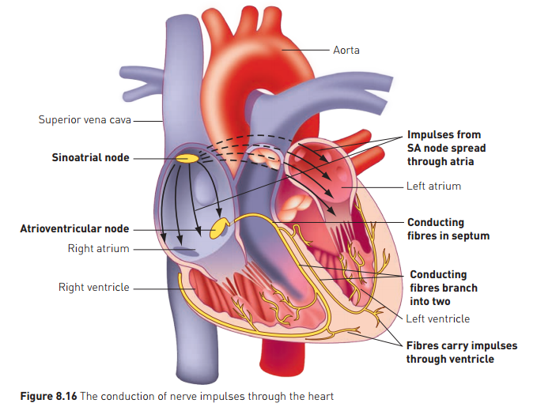

Slide 10
Changes to Blood Flow During Exercise
Activity of muscles cells uses oxygen, releases carbon dioxide waste
In order to supply cells with more oxygen, and carry away carbon dioxide, the Cardiac Output increases (along with rate of breathing)
Blood Vessels to muscles dilate, for better supply
Vessels in other internal organs constrict, to direct blood to muscles
Sympathetic stimulation assists with this via release of adrenaline.

Slide 11
Effect of Behaviour
Conscious input can affect how the body responds
Heart Rate
Cardiac Output
Breathing Rate
Eg: before an exam or test:
Feeling nervous about the test stimulates Sympathetic NS, and Cortisol release:
Increase in Blood Glucose to supply muscles
Dilation of Vessels to muscles
Increase in Respiratory Rate.
Even though the test may not involve physical exertion, the body anticipates the “flight or fight” response.

